Slide 1
AZ-700T00A Module 04: Load balancing non-HTTP(S) traffic

Slide 2
Module Overview
Lesson 01: Explore load balancing options in the Azure portal
Lesson 02: Design and implement Azure Load Balancer using the Azure portal
Lesson 03: Exercise - Create and configure an internal load balancer using the Azure portal
Lesson 04: Explore Azure Traffic Manager
Lesson 05: Exercise: create a traffic manager profile using the Azure portal
Notes:
Design and Implement Routing (25–30%)
Design and implement an Azure Load Balancer
• choose an Azure Load Balancer SKU (Basic versus Standard)
• choose between public and internal
• create and configure an Azure Load Balancer (including cross-region)
• implement a load balancing rule
• create and configure inbound NAT rules
• create explicit outbound rules for a load balancer
Implement an Azure Traffic Manager profile
• configure a routing method (mode)
• configure endpoints
• create HTTP settings

Slide 3
Lesson 01: Explore load balancing options in the Azure portal
Notes:
- Virtual networks (the hub-spoke topology)
- ExpressRoute (including ExpressRoute gateways)
- Site-to-site VPN and Point-to-site VPN (including VPN gateways)
- Virtual WAN
- VNet peering
- Azure Firewall
- Virtual network DDoS
- User Defined Routes
- Azure Bastion

Slide 4
Explore load balancing options in the Azure portal overview
What is a Load balancer
Load balancing options for Azure
Choosing a load balancing option
Demonstration
Review
Notes:
Configure and manage virtual networking (25–30%)
Configure load balancing
* Configure an internal or public load balancer.
* Troubleshoot load-balancing.

Slide 5




What is a Load balancer
www.contoso.com
IP
Public IP
www.contoso.com
IP
Public IP
Notes:
With Azure Load Balancer, you can scale your applications and create highly available services. Load balancer supports both inbound and outbound scenarios. Load balancer provides low latency and high throughput, and scales up to millions of flows for all TCP and UDP applications.
Key scenarios that you can accomplish using Azure Standard Load Balancer include:
Load balance internal and external traffic to Azure virtual machines.
Increase availability by distributing resources within and across zones.
Configure outbound connectivity for Azure virtual machines.
Use health probes to monitor load-balanced resources.
Employ port forwarding to access virtual machines in a virtual network by public IP address and port.
Enable support for load-balancing of IPv6.
Standard load balancer provides multi-dimensional metrics through Azure Monitor. These metrics can be filtered, grouped, and broken out for a given dimension. They provide current and historic insights into performance and health of your service. Insights for Azure Load Balancer offers a preconfigured dashboard with useful visualizations for these metrics. Resource Health is also supported. Review Standard load balancer diagnostics for more details.
Load balance services on multiple ports, multiple IP addresses, or both.
Move internal and external load balancer resources across Azure regions.
Load balance TCP and UDP flow on all ports simultaneously using HA ports.

Slide 6
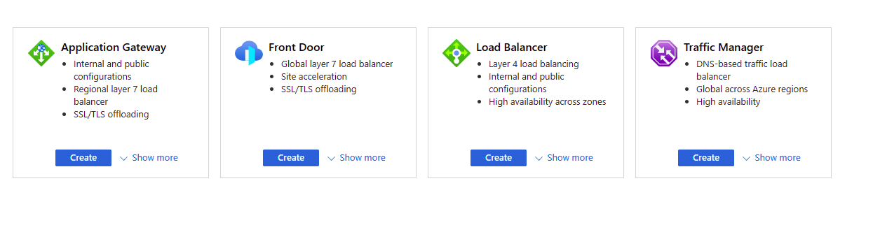
Load balancing options for Azure
Notes:
Global vs regional
Global load-balancing services distribute traffic across regional backends, clouds, or hybrid on-premises services. These services route end-user traffic to the closest available backend. They also react to changes in service reliability or performance, in order to maximize availability and performance.
Regional load-balancing services distribute traffic within virtual networks across virtual machines (VMs) or zonal and zone-redundant service endpoints within a region. You can think of them as systems that load balance between VMs, containers, or clusters within a region in a virtual network.
HTTP(S) load-balancing services are Layer 7 load balancers that only accept HTTP(S) traffic. They are intended for web applications or other HTTP(S) endpoints. They include features such as SSL offload, web application firewall, path-based load balancing, and session affinity.
non-HTTP(S) load-balancing services can handle non-HTTP(S) traffic and are recommended for non-web workloads.
Azure provides various load balancing services that you can use to distribute your workloads across multiple computing resources, but the following are the main services:
Azure Load Balancer - this is a high-performance, ultra-low-latency Layer 4 load-balancing service (inbound and outbound) for all UDP and TCP protocols. It is built to handle millions of requests per second while ensuring your solution is highly available. Azure Load Balancer is zone-redundant, ensuring high availability across Availability Zones.
Traffic Manager - this is a DNS-based traffic load balancer that enables you to distribute traffic optimally to services across global Azure regions, while providing high availability and responsiveness. Because Traffic Manager is a DNS-based load-balancing service, it load-balances only at the domain level. For that reason, it can't fail over as quickly as Front Door, because of common challenges around DNS caching and systems not honoring DNS time-to-live values (TTLs).
Azure Application Gateway - this provides application delivery controller (ADC) as a service, offering various Layer 7 load-balancing capabilities. Use it to optimize web farm productivity by offloading CPU-intensive SSL termination to the gateway.
Azure Front Door - this is an application delivery network that provides global load balancing and site acceleration service for web applications. It offers Layer 7 capabilities for your application like SSL offload, path-based routing, fast failover, caching, etc. to improve performance and high-availability of your applications.

Slide 7
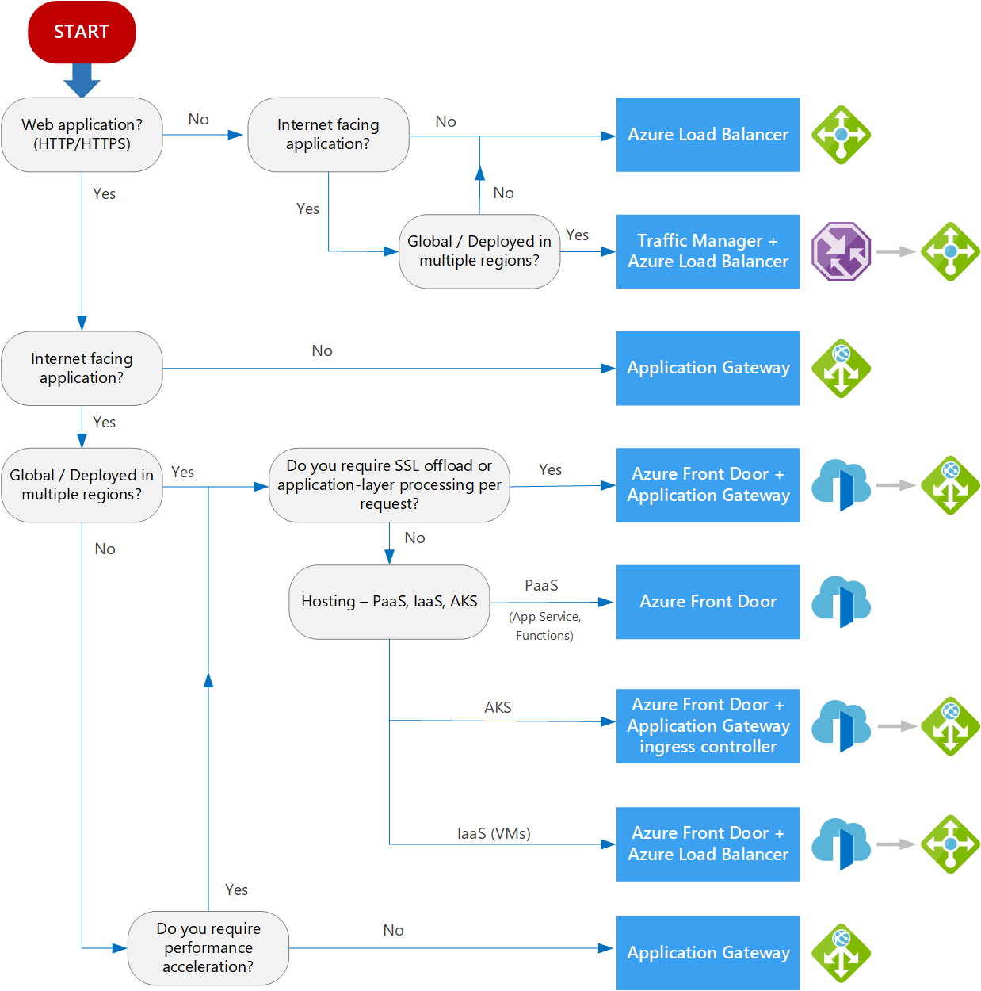
Choosing a load balancing option
Type of traffic
Scope
Availability
Cost
Features and limitations
Notes:
When choosing an appropriate load balancing option, there are some key factors to consider:
Type of traffic - is it for a web application? Is it a public-facing or private application?
Scope - do you need to load balance virtual machines and containers within a virtual network, or load balance across regions, or both? (see 'Global versus regional' above)
Availability - what is the Service Level Agreement (SLA) for the service?
Cost - In addition to the cost of the actual service itself, consider the operational cost to manage and maintain a solution built on that service. See Load balancing pricing.
Features and limitations - what features and benefits does each service provide, and what are its limitations? See Load balancer limits.

Slide 8
Demonstration
Create the virtual network
Create load balancer
Create backend servers and test virtual machine with IIS installed
Test the load balancer
Notes:
Quickstart: Create an internal load balancer - Azure portal - Azure Load Balancer | Microsoft Docs

Slide 9
Summary and Resources – Explore load balancing options in the Azure portal
Knowledge Check Questions
Microsoft Learn Modules (docs.microsoft.com/Learn)
Improve application scalability and resiliency by using Azure Load Balancer
Notes:
Learn - https://docs.microsoft.com/en-us/learn/browse

Slide 10
Lesson 02: Design and implement Azure Load balancer

Slide 11
Design and implement Azure Load Balancer overview
Determine Load Balancer type
Configure Session Persistence
Azure Load balancer and availability zones
Create Health Probes
Determine Load Balancer SKUs
Configure outbound traffic with Standard load balancer
Create Load balancer in the Azure portal
Demonstration
Create Backend Pools
Review
Create Load Balancer Rules

Slide 12
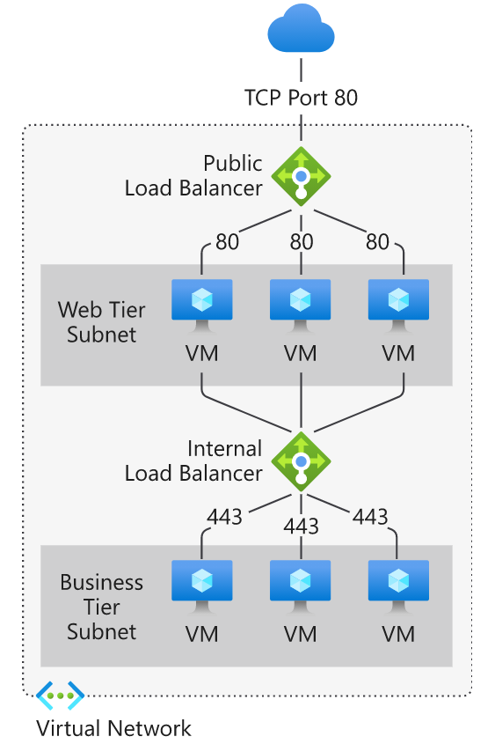
Choosing a Load Balancer Type
A public load balancer can provide outbound connections for virtual machines (VMs) inside your virtual network
An internal load balancer is used where private IPs are needed at the frontend only
Notes:
Load balancers can be public (a.k.a. external) or internal (a.k.a. private).
A public load balancer can provide outbound connections for virtual machines (VMs) inside your virtual network. These connections are accomplished by translating their private IP addresses to public IP addresses. External load balancers are used to distribute client traffic from the internet across your VMs. That internet traffic might come from web browsers, module apps, or other sources.
An internal load balancer is used where private IPs are needed at the frontend only. Internal load balancers are used to load balance traffic from internal Azure resources to other Azure resources inside a virtual network. A load balancer frontend can also be accessed from an on-premises network in a hybrid scenario.

Slide 13
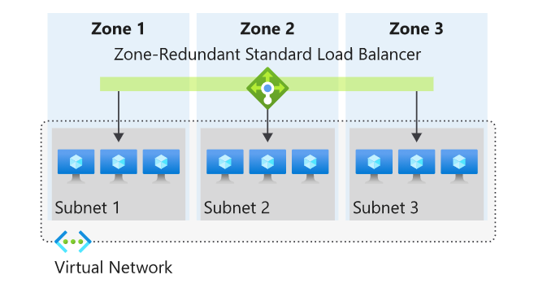
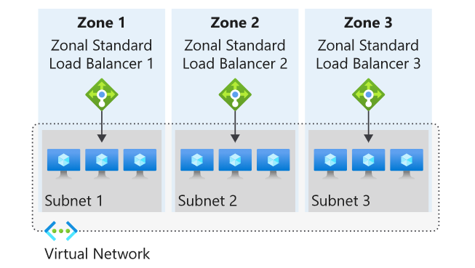
Azure Load balancer and availability zones
Zone redundant
Zonal
Notes:
Zone redundant
In a region with Availability Zones, a Standard Load Balancer can be zone-redundant. This traffic is served by a single IP address.
A single frontend IP address will survive zone failure. The frontend IP may be used to reach all (non-impacted) backend pool members no matter the zone. One or more availability zones can fail and the data path survives as long as one zone in the region remains healthy.
The frontend's IP address is served simultaneously by multiple independent infrastructure deployments in multiple availability zones. Any retries or reestablishment will succeed in other zones not affected by the zone failure.
Zonal
You can choose to have a frontend guaranteed to a single zone, which is known as a zonal. This scenario means any inbound or outbound flow is served by a single zone in a region. Your frontend shares fate with the health of the zone. The data path is unaffected by failures in zones other than where it was guaranteed. You can use zonal frontends to expose an IP address per Availability Zone.
Additionally, the use of zonal frontends directly for load balanced endpoints within each zone is supported. You can use this configuration to expose per zone load-balanced endpoints to individually monitor each zone.

Slide 14
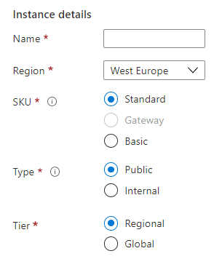
Determine Load Balancer SKUs
Feature | Basic SKU | Standard SKU
Backend pool | Up to 300 instances | Up to 1000 instances
Health probes | TCP, HTTP | TCP, HTTP, HTTPS
Availability zones | Not available | Zone-redundant and zonal frontends for inbound and outbound traffic
Multiple frontends | Inbound only | Inbound and outbound
Secure by default | Open by default. NSG optional. | Closed to inbound flows unless allowed by a NSG. Internal traffic from the virtual network to the internal load balancer is allowed.
SLA | Not available | 99.99%
Notes:
Load balancer SKUs - https://docs.microsoft.com/en-us/azure/load-balancer/skus
Azure Load Balancer has 3 SKUs - Basic, Standard, and Gateway. Each SKU is catered towards a specific scenario and has differences in scale, features, and pricing.
To compare and understand the differences between Basic and Standard SKU, use the table. For information on Gateway SKU - catered for third-party network virtual appliances (NVAs) currently in preview, see Gateway Load Balancer overview (https://docs.microsoft.com/azure/load-balancer/gateway-overview)
SKUs aren't mutable. You can't change the SKU of an existing resource.
A standalone virtual machine resource, availability set resource, or virtual machine scale set resource can reference one SKU, never both.
Move operations:
Resource group move operations (within same subscription) are supported for Standard Load Balancer and Standard Public IP.
Subscription group move operations are not supported for Standard Load Balancer and Standard Public IP resources.

Slide 15
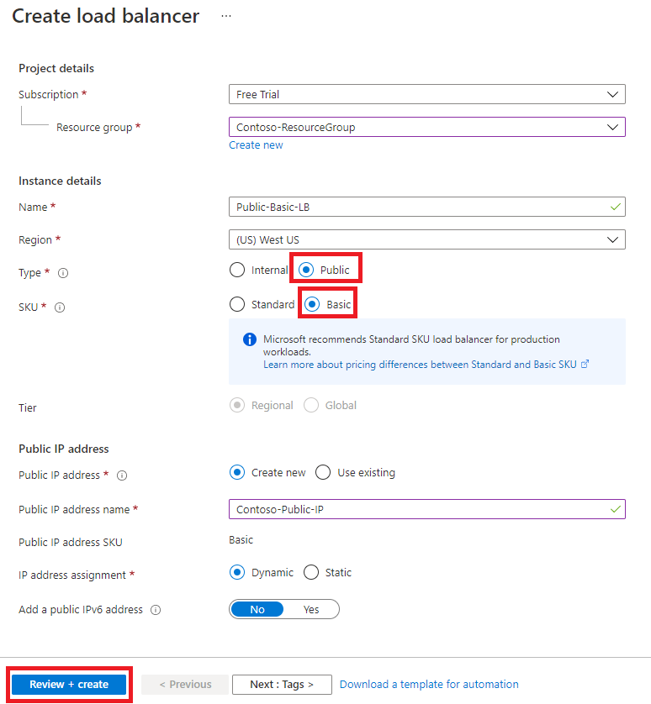
Create Load balancer in the Azure portal
Subscription
Name
Region
Type
SKU
Tier

Slide 16
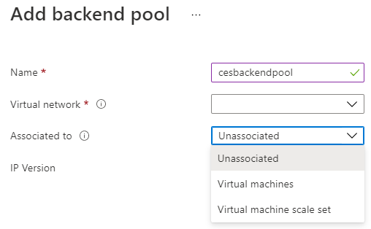
Create Backend Pools
SKU | Backend pool endpoints
Basic SKU | VMs in a single availability set or VM scale set
Standard SKU | Any VM in a single virtual network, including a blend of VMs, availability sets, and VM scale sets
To distribute traffic, a back-end address pool contains the IP addresses of the virtual NICs that are connected to the load balancer
Notes:
✔ In the Standard SKU you can have up to 1000 instances in the backend pool. In the Basic SKU you can have up to 100 instances.

Slide 17
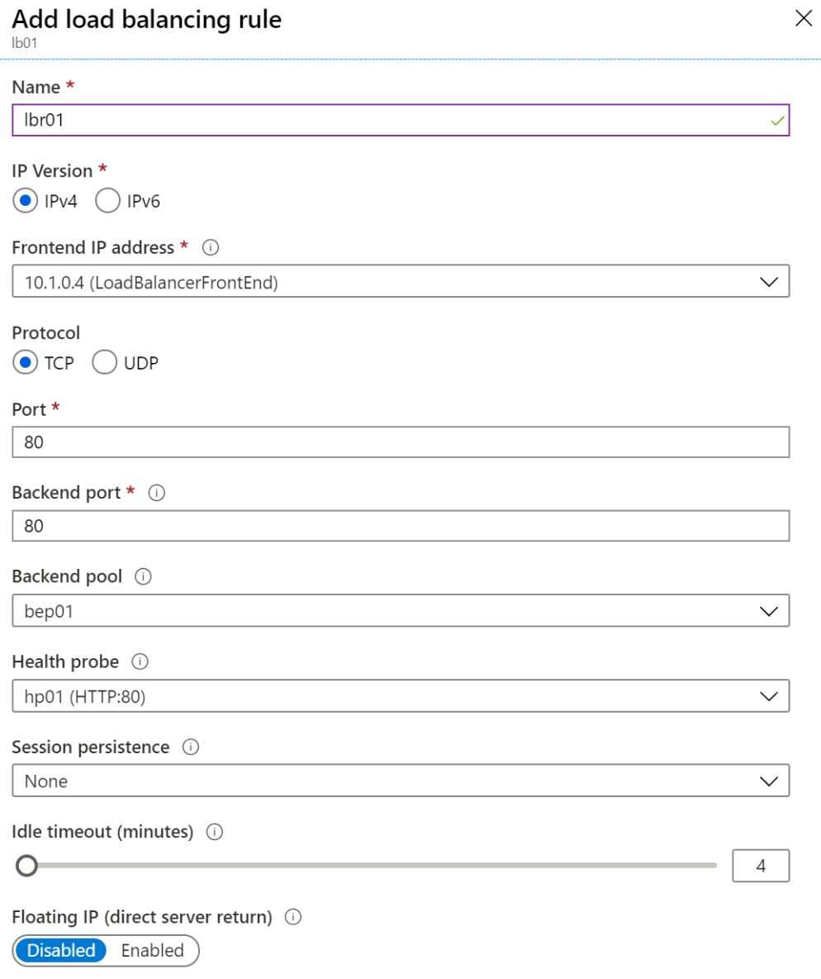
Create Load Balancer Rules
Maps a frontend IP and port combination to a set of backend pool and port combination
Rules can be used in combination with NAT rules
A NAT rule is explicitly attached to a VM (or network interface) to complete the path to the target
Notes:
Tutorial: Load balance internet traffic to VMs using the Azure portal - https://docs.microsoft.com/en-us/azure/load-balancer/tutorial-load-balancer-standard-manage-portal
✔ Can you see the difference between load balancing rules and NAT rules? Remember, this approach should only be used when you need connectivity from the Internet. Most normal communications would occur from on-premises to Azure connections such as site-to-site VPN and ExpressRoute.

Slide 18
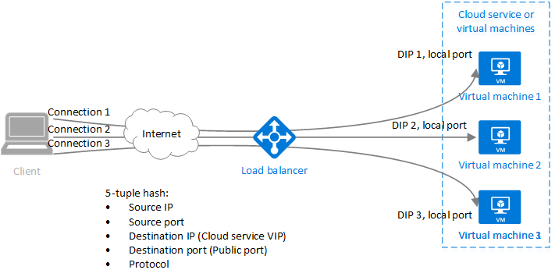
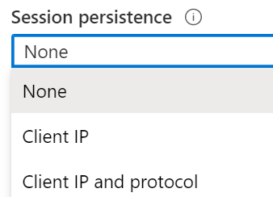
Configure Session Persistence
Session persistence specifies how client traffic is handled
None (default) requests can be handled by any virtual machine
Client IP requests will be handled by the same virtual machine
Client IP and protocol specifies that successive requests from the same address and protocol will be handled by the same virtual machine
Notes:
✔Keeping session persistence information is very important in applications that use a shopping cart. Can you think of any other applications?

Slide 19
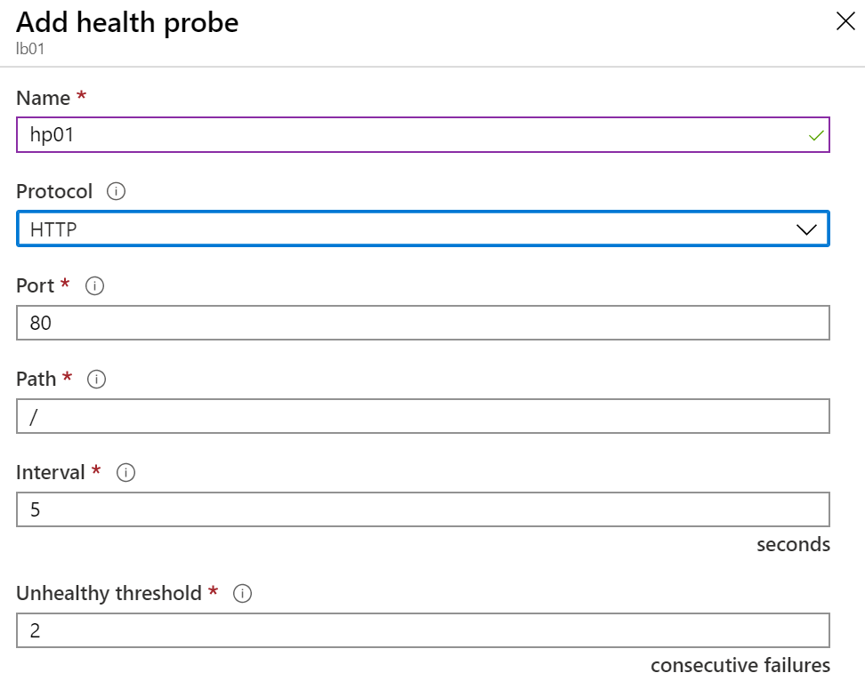
Create Health Probes
Allows the load balancer to monitor the status of an app
Dynamically adds or removes VMs from the load balancer rotation based on their response to health checks
HTTP custom probe
TCP custom probe tries to establish a successful TCP session
Notes:
Load Balancer health probes - https://docs.microsoft.com/en-us/azure/load-balancer/load-balancer-custom-probe-overview
✔ There is also a guest agent probe. This probe uses the guest agent inside the VM. It is not recommended when HTTP or TCP custom probe configurations are possible. Relate back to the original diagram to ensure all the components are covered.

Slide 20
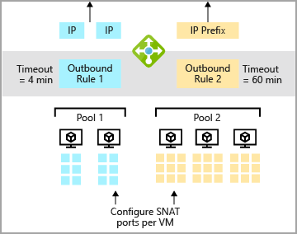
Configure outbound traffic with Standard load balancer
source network address translation (SNAT)
Outbound rules allow you to explicitly define SNAT
IP masquerading
Simplifying your allow lists
Reduces the number of public IP resources for deployment.
Notes:
How to configure internet outbound:
Certain scenarios require virtual machines or compute instances to have outbound connectivity to the internet. The frontend IPs of an Azure public load balancer can be used to provide outbound connectivity to the internet for backend instances. This configuration uses source network address translation (SNAT) as the source or virtual machine's IP is translated to a public IP address. SNAT maps the IP address of the backend to the public IP address of your load balancer. SNAT prevents outside sources from having a direct address to the backend instances.
Outbound rules allow you to explicitly define SNAT(source network address translation) for a public standard load balancer. This configuration allows you to use the public IP(s) of your load balancer to provide outbound internet connectivity for your backend instances.
This configuration enables:
IP masquerading
Simplifying your allowlists.
Reduces the number of public IP resources for deployment.
With outbound rules, you have full declarative control over outbound internet connectivity. Outbound rules allow you to scale and tune this ability to your specific needs.
Outbound rules will only be followed if the backend VM doesn't have an instance-level public IP address (ILPIP).

Slide 21
Demonstration
Create the virtual network
Create public load balancer
Create backend pool
Create a health probe
Notes:
Show azure portal and load balancing option
Deploy an External LB with 2 VMs in a backend pool
Quickstart: Create a public load balancer - Azure portal - Azure Load Balancer | Microsoft Docs

Slide 22
Review – Design and implement Azure Load Balancer
Check your knowledge
Microsoft Learn Modules (docs.microsoft.com/Learn)
What is Azure Load Balancer? - Azure Load Balancer | Microsoft Docs

Slide 23
Lesson 03: Exercise - Create and configure an internal load balancer using the Azure portal

Slide 24
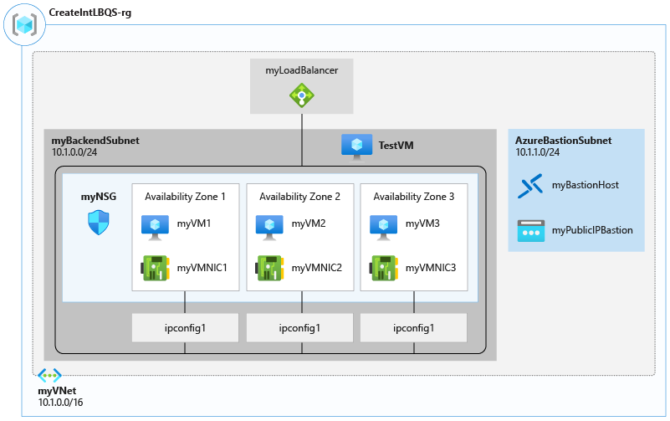
Exercise - Create and configure an Azure load balancer
Task 1: Create the virtual network
Task 2: Create the load balancer
Task 3: Create load balancer resources
Task 4: Create backend servers
Task 5: Test the load balancer
Notes:
AZ-700-Designing-and-Implementing-Microsoft-Azure-Networking-Solutions/4-exercise-create-configure-azure-load-balancer.md at master · MicrosoftLearning/AZ-700-Designing-and-Implementing-Microsoft-Azure-Networking-Solutions (github.com)
https://microsoftlearning.github.io/AZ-700-Designing-and-Implementing-Microsoft-Azure-Networking-Solutions/Instructions/Exercises/M04-Unit%204%20Create%20and%20configure%20an%20Azure%20load%20balancer.html
Task 1: Create the virtual network
Task 2: Create the load balancer
Task 3: Create load balancer resources
Task 4: Create backend servers
Task 5: Test the load balancer

Slide 25
Review – Exercise create and configure an internal load balancer using the Azure portal
Check your knowledge
Microsoft Learn Modules (docs.microsoft.com/Learn)
Quickstart: Create a public load balancer - Azure portal - Azure Load Balancer | Microsoft Docs

Slide 26
Lesson 04: Explore Azure Traffic Manager

Slide 27
Explore Azure Traffic Manager overview
Use cases for Azure Traffic Manager
Configuring traffic manager profiles
How Traffic manager works
Configure Endpoint monitoring
Traffic routing methods
Demonstration
Traffic manager endpoints
Review

Slide 28
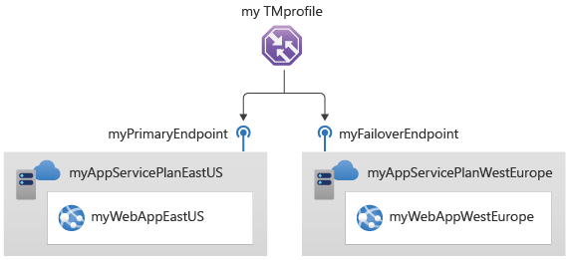
Use cases for Azure Traffic Manager
Increase application availability
Improve application performance
Service maintenance without downtime
Combine hybrid applications
Distribute traffic for complex deployments
Notes:
Feature
Increase application availability: Traffic Manager delivers high availability for your critical applications by monitoring your endpoints and providing automatic failover when an endpoint goes down.
Improve application performance: Azure allows you to run cloud services and websites in datacenters located around the world. Traffic Manager can improve the responsiveness of your website by directing traffic to the endpoint with the lowest latency.
Service maintenance without downtime: You can have planned maintenance done on your applications without downtime. Traffic Manager can direct traffic to alternative endpoints while the maintenance is in progress.
Combine hybrid applications: Traffic Manager supports external, non-Azure endpoints enabling it to be used with hybrid cloud and on-premises deployments, including the burst-to-cloud, migrate-to-cloud, and failover-to-cloud scenarios.
Distribute traffic for complex deployments: Using nested Traffic Manager profiles, multiple traffic-routing methods can be combined to create sophisticated and flexible rules to scale to the needs of larger, more complex deployments.
Azure Traffic Manager is a DNS-based traffic load balancer. This service allows you to distribute traffic to your public facing applications across the global Azure regions. Traffic Manager also provides your public endpoints with high availability and quick responsiveness.
Traffic Manager uses DNS to direct the client requests to the appropriate service endpoint based on a traffic-routing method. Traffic manager also provides health monitoring for every endpoint. The endpoint can be any Internet-facing service hosted inside or outside of Azure. Traffic Manager provides a range of traffic-routing methods and endpoint monitoring options to suit different application needs and automatic failover models. Traffic Manager is resilient to failure, including the failure of an entire Azure region.

Slide 29
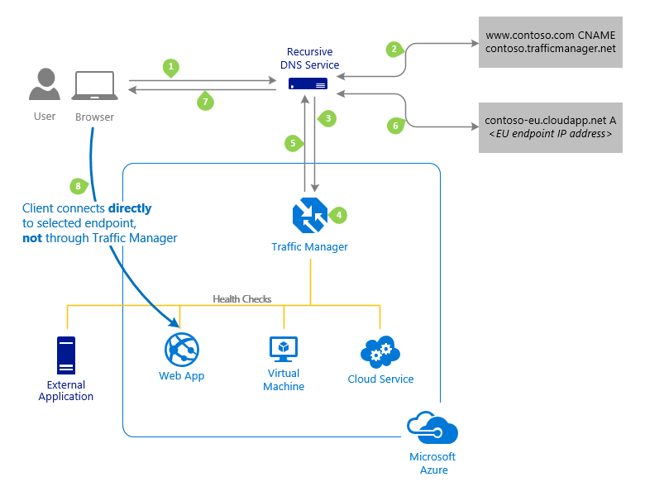
How Traffic manager works
The Traffic Manager name servers receive the request. They choose an endpoint based on:
The configured state of each endpoint
The current health of each endpoint, as determined by the Traffic Manager health checks
The chosen traffic-routing method
Final connection is not going through Traffic Manager
Notes:
The client sends a DNS query to its configured recursive DNS service to resolve the name 'partners.contoso.com'. A recursive DNS service, sometimes called a 'local DNS' service, does not host DNS domains directly. Rather, the client off-loads the work of contacting the various authoritative DNS services across the Internet needed to resolve a DNS name.
To resolve the DNS name, the recursive DNS service finds the name servers for the 'contoso.com' domain. It then contacts those name servers to request the 'partners.contoso.com' DNS record. The contoso.com DNS servers return the CNAME record which points to contoso.trafficmanager.net.
Next, the recursive DNS service finds the name servers for the 'trafficmanager.net' domain, which are provided by the Azure Traffic Manager service. It then sends a request for the 'contoso.trafficmanager.net' DNS record to those DNS servers.
The Traffic Manager name servers receive the request. They choose an endpoint based on:
The configured state of each endpoint (disabled endpoints are not returned).
The current health of each endpoint, as determined by the Traffic Manager health checks (see Endpoint Monitoring Options).
The chosen traffic-routing method (see Traffic Routing Methods).
The chosen endpoint is returned as another DNS CNAME record. In this case, let us suppose contoso-eu.cloudapp.net is returned.
Next, the recursive DNS service finds the name servers for the 'cloudapp.net' domain. It contacts those name servers to request the 'contoso-eu.cloudapp.net' DNS record. A DNS 'A' record containing the IP address of the EU-based service endpoint is returned.
The recursive DNS service consolidates the results and returns a single DNS response to the client.
The client receives the DNS results and connects to the given IP address. The client connects to the application service endpoint directly, not through Traffic Manager. Since it is an HTTPS endpoint, the client performs the necessary SSL/TLS handshake, and then makes an HTTP GET request for the '/login.aspx' page.

Slide 30
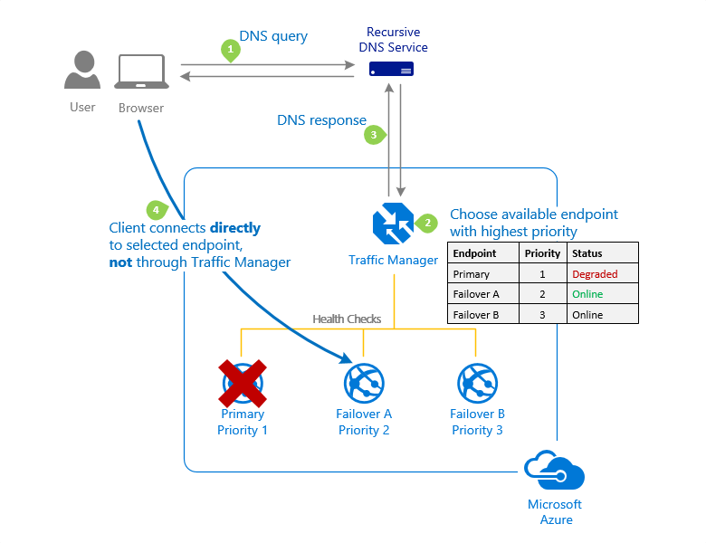
Traffic routing methods – Priority
Notes:
Azure Traffic Manager supports six traffic-routing methods to determine how to route network traffic to the various service endpoints. For any profile, Traffic Manager applies the traffic-routing method associated to it to each DNS query it receives. The traffic-routing method determines which endpoint is returned in the DNS response.
The following traffic routing methods are available in Traffic Manager:
Routing method
Priority
Select this routing method when you want to have a primary service endpoint for all traffic. You can provide multiple backup endpoints in case the primary or one of the backup endpoints is unavailable.
Weighted
Select this routing method when you want to distribute traffic across a set of endpoints based on their weight. Set the weight the same to distribute evenly across all endpoints.
Performance
Select the routing method when you have endpoints in different geographic locations, and you want end users to use the "closest" endpoint for the lowest network latency.
Geographic
Select this routing method to direct users to specific endpoints (Azure, External, or Nested) based on where their DNS queries originate from geographically. With this routing method, it enables you to be compliant with scenarios such as data sovereignty mandates, localization of content & user experience and measuring traffic from different regions.
MultiValue
Select this routing method for Traffic Manager profiles that can only have IPv4/IPv6 addresses as endpoints. When a query is received for this profile, all healthy endpoints are returned.
Subnet
Select this routing method to map sets of end-user IP address ranges to a specific endpoint. When a request is received, the endpoint returned will be the one mapped for that request’s source IP address.

Slide 31
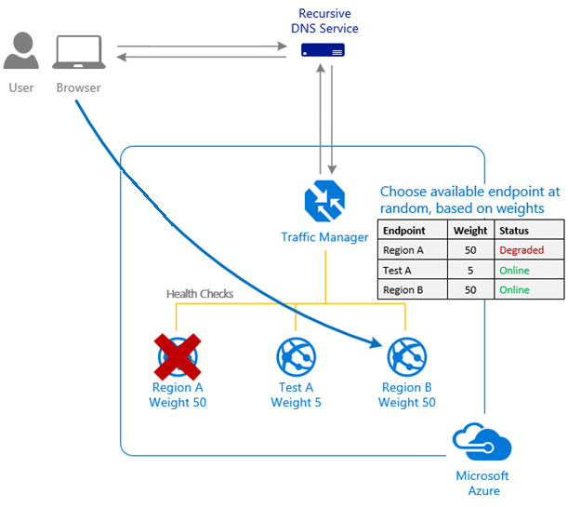
Traffic routing methods – Weighted
Notes:
Weighted
Select this routing method when you want to distribute traffic across a set of endpoints based on their weight. Set the weight the same to distribute evenly across all endpoints.
You want to distribute traffic across endpoints, either evenly or using different weights.

Slide 32
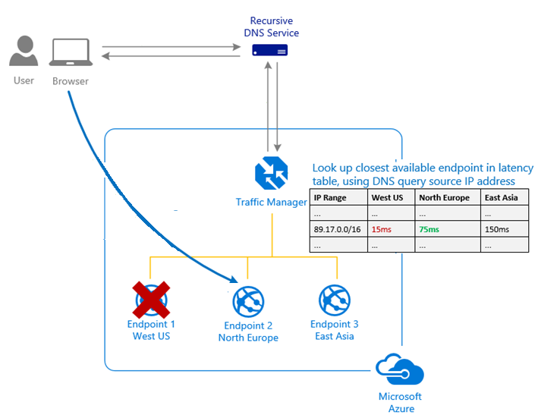
Traffic routing methods – Performance
Notes:
Performance
Select the routing method when you have endpoints in different geographic locations, and you want end users to use the "closest" endpoint for the lowest network latency.

Slide 33
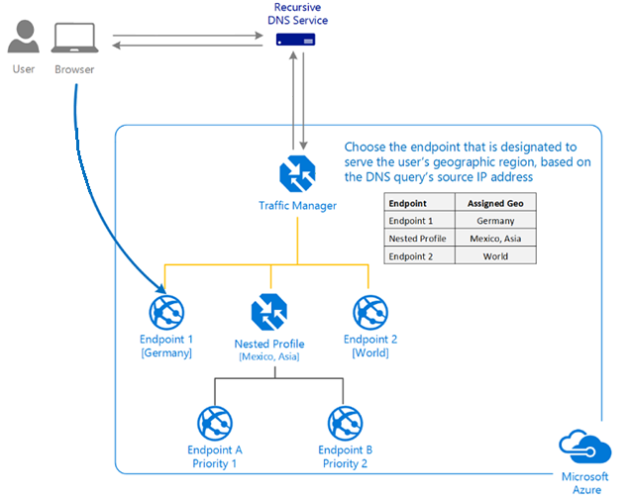
Traffic routing methods - Geographic
Notes:
Geographic
Select this routing method to direct users to specific endpoints (Azure, External, or Nested) based on where their DNS queries originate from geographically. With this routing method, it enables you to be compliant with scenarios such as data sovereignty mandates, localization of content & user experience and measuring traffic from different regions.

Slide 34
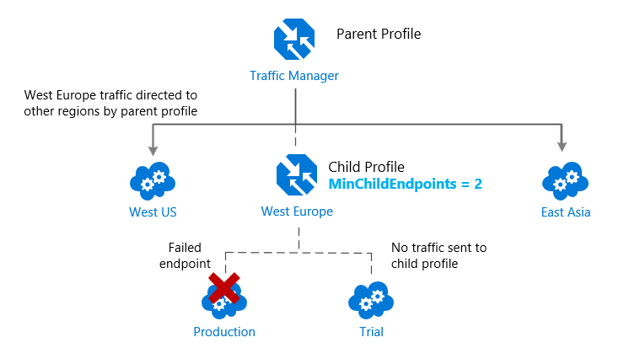
Traffic manager endpoints
Azure endpoints – load balance traffic to a cloud service, web app, or public IP address in the same subscription within Azure.
External endpoints - load balance traffic for IPv4/IPv6 addresses, FQDNs, or for services hosted outside Azure. These services can either be on-premises or with a hosting provider.
Nested endpoints - combine Traffic Manager profiles to create more flexible traffic-routing schemes to support the needs of larger, more complex deployments.
Notes:
Image shows example of combining Performance and Weighted traffic routing
Azure Traffic Manager enables you to control how network traffic is distributed to application deployments running in your different datacenters. You configure each application deployment as an endpoint in Traffic Manager. When Traffic Manager receives a DNS request, it chooses an available endpoint to return in the DNS response. Traffic manager bases the choice on the current endpoint status and the traffic-routing method.
Traffic Manager supports three types of endpoints:
Azure endpoints - Use this type of endpoint to load-balance traffic to a cloud service, web app, or public IP address in the same subscription within Azure.
External endpoints - Use this type of endpoint to load balance traffic for IPv4/IPv6 addresses, FQDNs, or for services hosted outside Azure. These services can either be on-premises or with a different hosting provider.
Nested endpoints - Use this type of endpoint to combine Traffic Manager profiles to create more flexible traffic-routing schemes to support the needs of larger, more complex deployments. With Nested endpoints, a child profile is added as an endpoint to a parent profile. Both the child and parent profiles can contain other endpoints of any type, including other nested profiles.
There are no restrictions on how different endpoints types can be combined in a single Traffic Manager profile; each profile can contain any mix of endpoint types.
You add endpoints to existing Traffic Manager profiles from the Endpoints page of a Traffic Manager profile in the Azure portal.

Slide 35
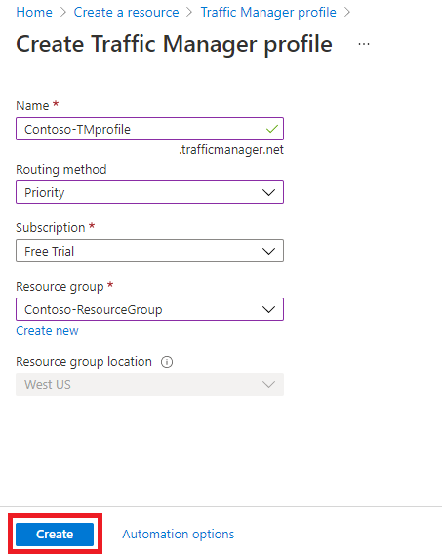
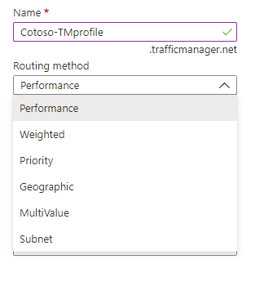
Configuring traffic manager profiles

Slide 36
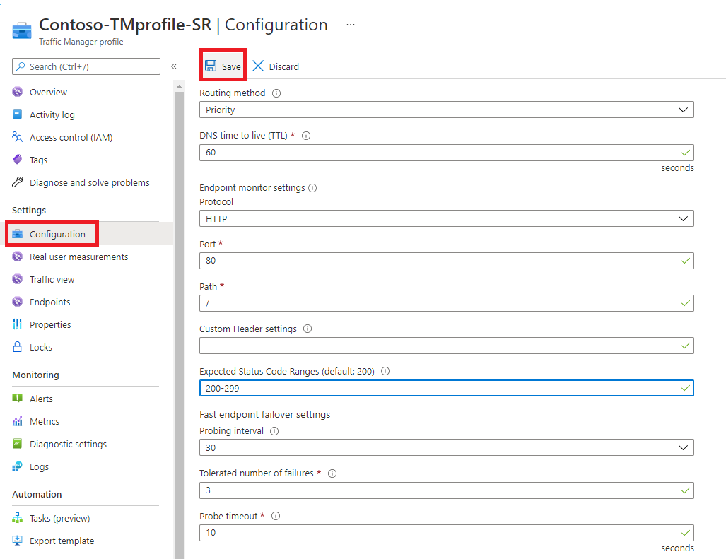
Configure Endpoint monitoring
Open the Configuration page for the Traffic Manager profile
Select Endpoint monitor settings section, and specify the following settings: Protocol
Port
Path
Custom header settings
Expected status code ranges
Probing interval
tolerated number of failures
probe timeout
Notes:
When the monitoring protocol is set as HTTP or HTTPS, the Traffic Manager probing agent makes a GET request to the endpoint using the protocol, port, and relative path given. An endpoint is considered healthy if probing agent receives a 200-OK response, or any of the responses configured in the Expected status code *ranges. If the response is a different value or no response get received within the timeout period, the Traffic Manager probing agent reattempts according to the Tolerated Number of Failures setting. No reattempts are done if this setting is 0. The endpoint is marked unhealthy if the number of consecutive failures is higher than the Tolerated Number of Failures setting.
When the monitoring protocol is TCP, the Traffic Manager probing agent creates a TCP connection request using the port specified. If the endpoint responds to the request with a response to establish the connection, that health check is marked as a success. The Traffic Manager probing agent resets the TCP connection. In cases where the response is a different value or no response get received within the timeout period, the Traffic Manager probing agent reattempts according to the Tolerated Number of Failures setting. No reattempts are made if this setting is 0. If the number of consecutive failures is higher than the Tolerated Number of Failures setting, then that endpoint is marked unhealthy.
In all cases, Traffic Manager probes from multiple locations. The consecutive failure determines what happen within each region. That is why endpoints are receiving health probes from Traffic Manager with a higher frequency than the setting used for Probing Interval.

Slide 37
Demonstration – Azure Traffic Manager
Create a Traffic Manager profile
Add Traffic Manager endpoints
Test Traffic Manager profile
Notes:
Quickstart: Create a profile for HA of applications - Azure portal - Azure Traffic Manager | Microsoft Docs

Slide 38
Summary – Azure Traffic Manager
Check your knowledge
Microsoft Learn Modules (docs.microsoft.com/Learn)
Azure Traffic Manager | Microsoft Docs
Tutorial - Improve website response with Azure Traffic Manager | Microsoft Docs

Slide 39
Lesson 05: Exercise- create a traffic manager profile using the Azure portal

Slide 40
Exercise- create a traffic manager profile using the Azure portal
Task 1: Create the web apps
Task 2: Create a Traffic Manager profile
Task 3: Add Traffic Manager endpoints
Task 4: Test the Traffic Manager profile
Notes:
AZ-700-Designing-and-Implementing-Microsoft-Azure-Networking-Solutions/6-exercise-create-traffic-manager-profile-using-azure-portal.md at master · MicrosoftLearning/AZ-700-Designing-and-Implementing-Microsoft-Azure-Networking-Solutions (github.com)
https://microsoftlearning.github.io/AZ-700-Designing-and-Implementing-Microsoft-Azure-Networking-Solutions/Instructions/Exercises/M04-Unit%206%20Create%20a%20Traffic%20Manager%20profile%20using%20the%20Azure%20portal.html
Task 1: Create the web apps
Task 2: Create a Traffic Manager profile
Task 3: Add Traffic Manager endpoints
Task 4: Test the Traffic Manager profile

Slide 41
End of presentation

